Slide 1
Subject to follow
Dear colleagues,
How are you? I think you are well & good. I would like to request you to read the notes in normal mood carefully below the ‘Click to add notes’ option to conduct the class spontaneously. If you think any change to take the class more effectively, you can do that. In case of any inquiry please call 01556652300.
Your near and dear
Md. Hasan Hafizur Rahman
Content developer (English)
Cambrian School & College
Dhaka.
Notes:
Teacher may read the instructions carefully before going to the class.

Slide 2
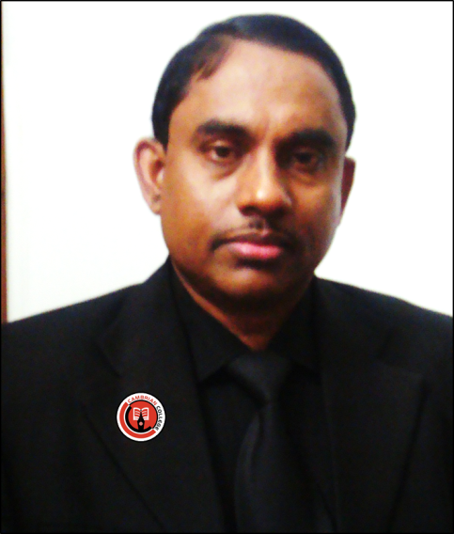
Introduction of the teacher & class
Md. Hasan Hafizur Rahman
Lecturer & Head of the Department (English)
Cambrian School & College
Dhaka
English for Today
Class-IX-X
Notes:
Introduction of teacher & Class.

Slide 3
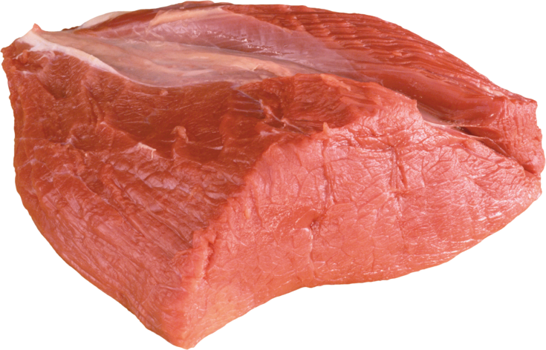
A pound of Flesh
It is our today’s lesson
Unit-14, Lesson-9
Notes:
Lesson declaration.

Slide 4

Learning outcomes
After studied this lesson, we will be able to –
ask and answer questions
read and understand the text through silent reading
tell the story
Notes:
Speaking, listening & reading skills will be focused.

Slide 5
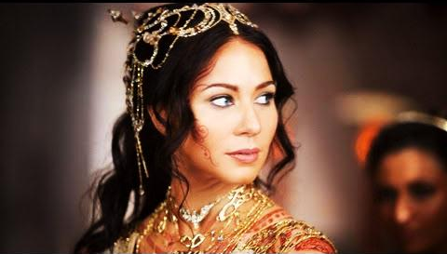
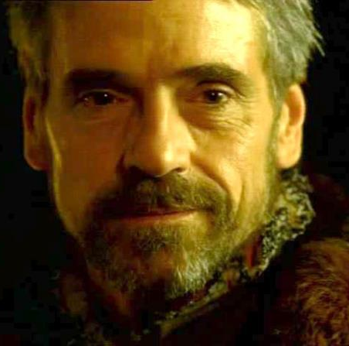
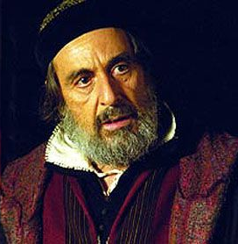
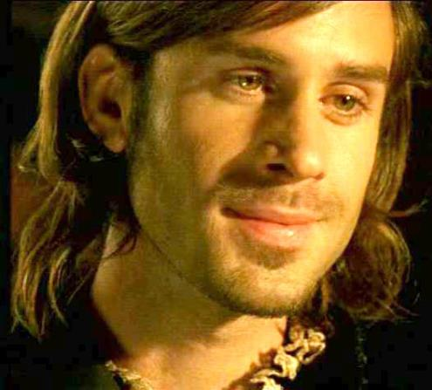
Do you know them?
Portia
and
The princess
of Belmont.
Antonio
Shylock
Bassanio
Notes:
Portia was the princess of Belmont.

Slide 6
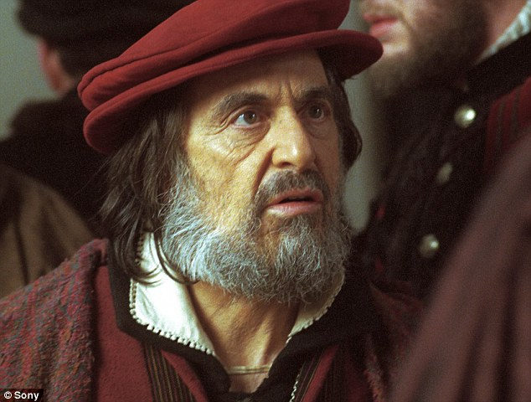
Shylock
A moneylender,
He used to lend money with a high interest.
Notes:
By recognition Shylock was a moneylender.

Slide 7
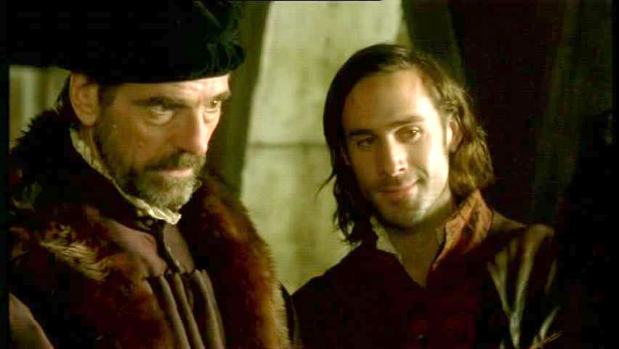
Intimate friends
Antonio
Bassanio
Antonio helped people with money without interest.
Notes:
They were two intimate friends. Antonio loved Bassanio more than his life.

Slide 8
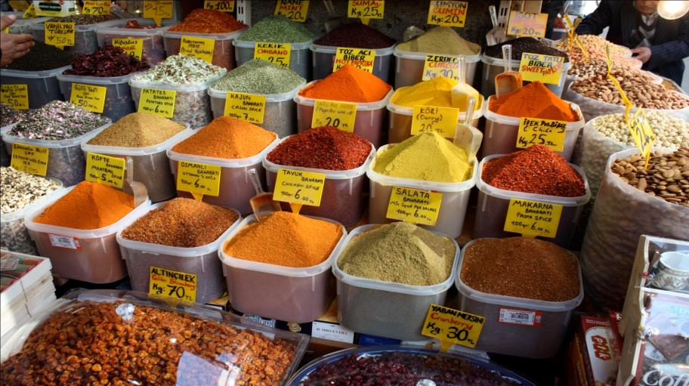
Let us know some new words to have clear idea about the topics.
Merchandise
Business materials,
daily using items
Antonio’s ship carried different types of merchandise to the other countries.
Notes:
If you want to show this option, just go according to the animation.

Slide 9
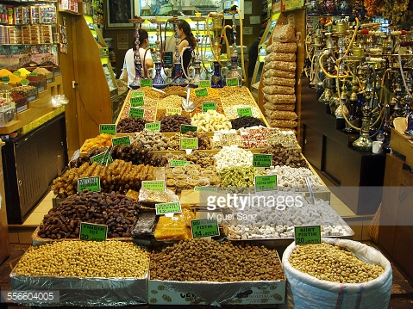
Spices
Cooking materials, flavors
Spices make foods tasty.
Notes:
Showing the word teacher may ask the meaning to the students, then he may show the picture, then meaning and sentence at last.

Slide 10

Luxurious
Deluxe, expensive, lavish, high status
Bassanio was in the habit of leading a luxurious life.
Notes:
Showing the word teacher may ask the meaning to the students, then he may show the picture, then meaning and sentence at last.

Slide 11
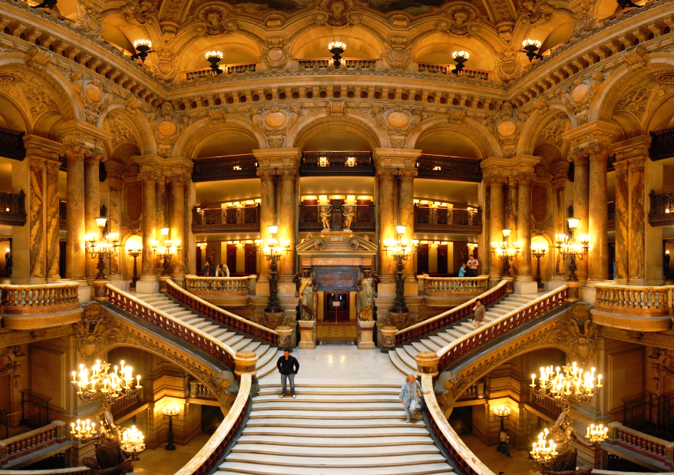
Grandeur
Aristocratic,
Splendor,
majesty, gravitas
Bassanio loved grandeur and style.
Notes:
Showing the word teacher may ask the meaning to the students, then he may show the picture, then meaning and sentence at last.

Slide 12
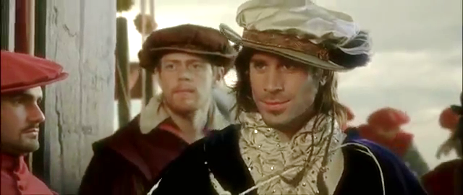
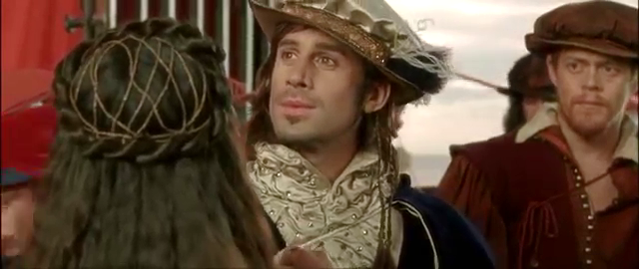
Grand manner
Royal dressed,
luxurious style,
view of prince
Bassanio visited Portia in a grand manner.
Notes:
Showing the word teacher may ask the meaning to the students, then he may show the picture, then meaning and sentence at last.

Slide 13
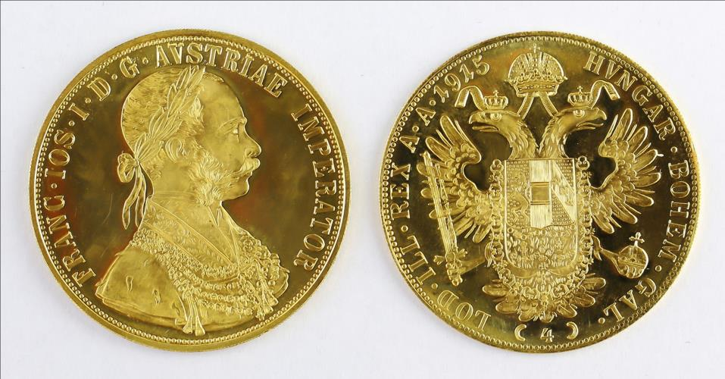
Venetian currency
Ducats
Money is called ducats in Venetian currency in Venice, Italy.
Notes:
Showing the word teacher may ask the meaning to the students, then he may show the picture, then meaning and sentence at last.

Slide 14
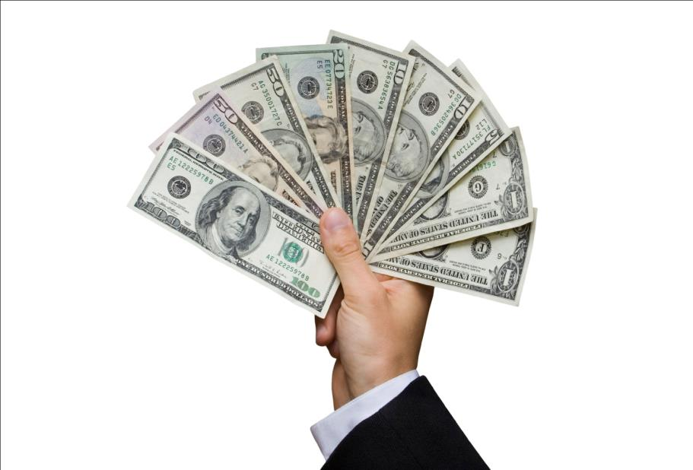
Moneylender
One who lends money. Pawnbroker,
usurer
Shylock was a cruel moneylender.
Notes:
Showing the word teacher may ask the meaning to the students, then he may show the picture, then meaning and sentence at last.

Slide 15
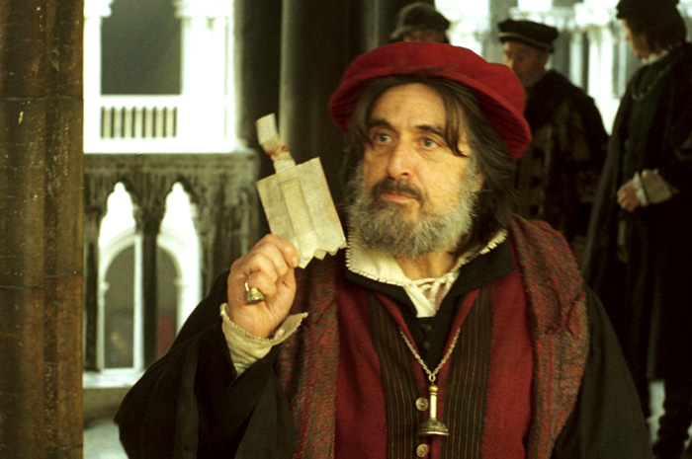
Crooked
Cruel, hypocritical, tortuous
Shylock was a crooked moneylender.
Notes:
Showing the word teacher may ask the meaning to the students, then he may show the picture, then meaning and sentence at last.

Slide 16
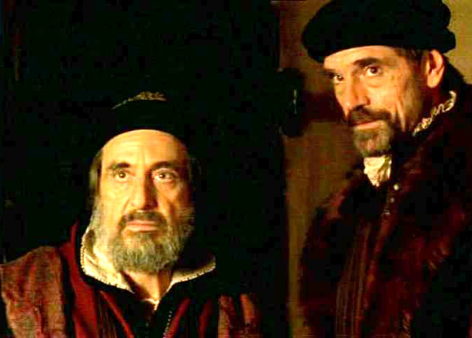
Debtor
Borrower
defaulter,
nonpayer
Antonio was a debtor to Shylock.
Notes:
Showing the word teacher may ask the meaning to the students, then he may show the picture, then meaning and sentence at last.

Slide 17
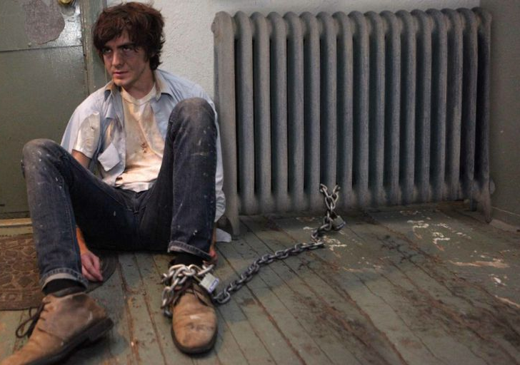
Penalty
Punishment,
guilt
Shylock claimed a pound of flesh as a penalty to Antonio.
Notes:
Showing the word teacher may ask the meaning to the students, then he may show the picture, then meaning and sentence at last.

Slide 18
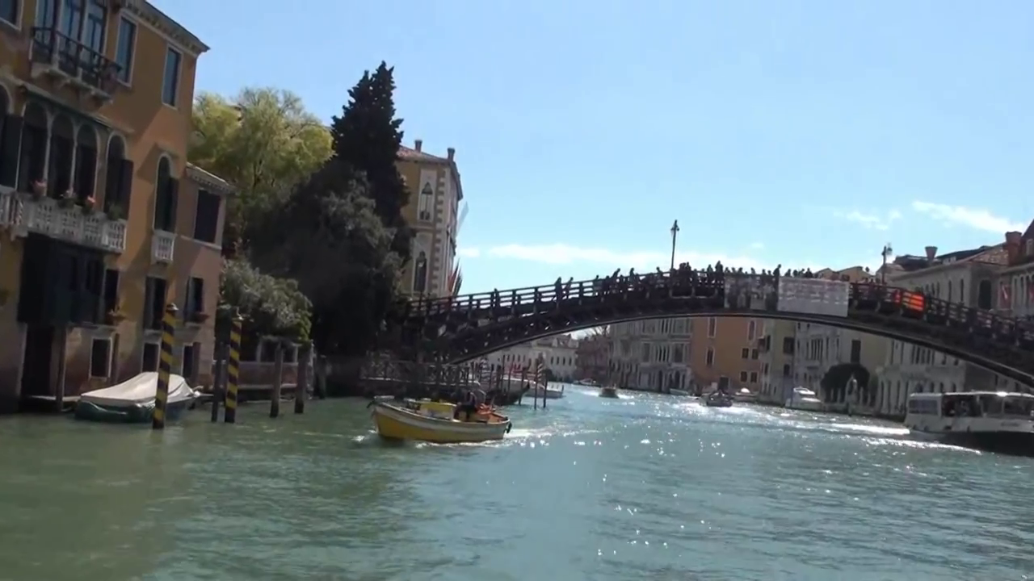
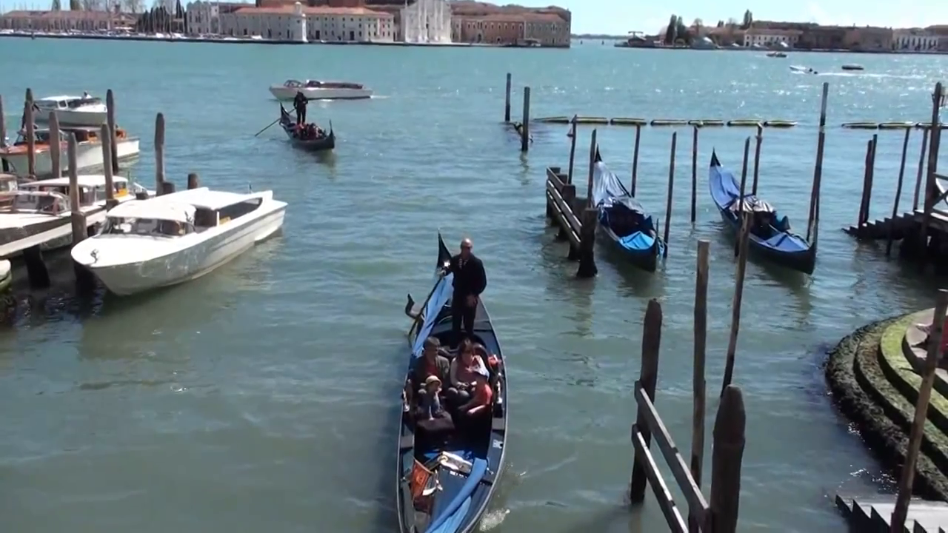
Venice, Italy
Shylock, Antonio and Bassanio lived in this city.
Notes:
Shylock, Antonio and Bassanio lived in this city-port. It is an important business port of Italy.

Slide 19
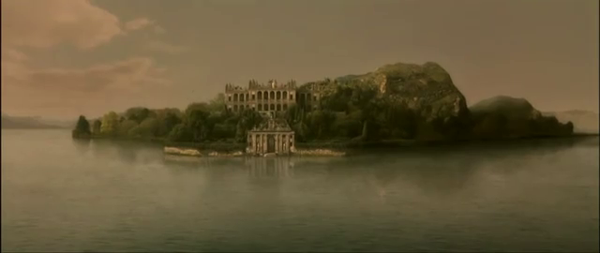
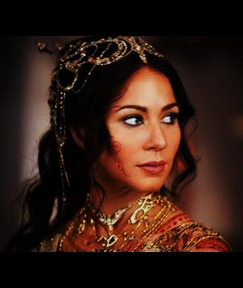
Belmont
Portia lived in Belmont.
Notes:
Belmont is an island of Australia where Princess Portia lived in. This picture shows Portia’s father’s state.

Slide 20
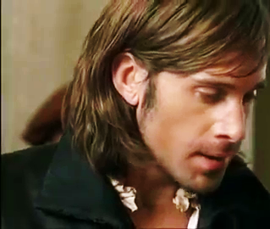
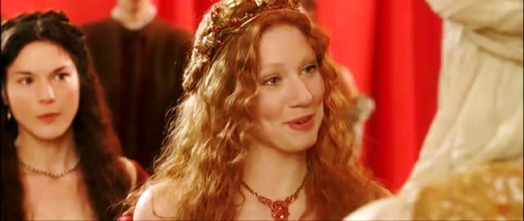
Bassanio and Portia loved each other.
Notes:
Bassanio loved Poria and portia had also softness to Bassanio.

Slide 21
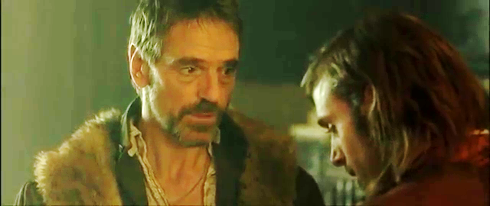
Bassanio wanted to visit Portia in a grand manner but he did not have enough money. So he went to Antonio.
Notes:
Bassanio is informing about his intention and financial crisis to Antonio.

Slide 22
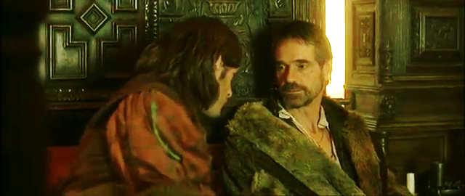
Bassanio said, “ Dear friend Antonio, I am in great need of some money. I would like to visit Portia at Belmont, grandly dressed and with many servants. But I don’t have any money right now. Please help me to fulfill my intention.”
Notes:
Bassanio wishing help from Antonio.

Slide 23
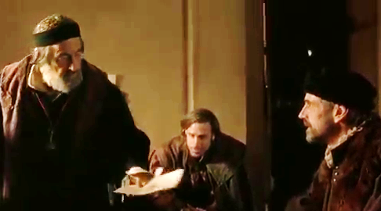
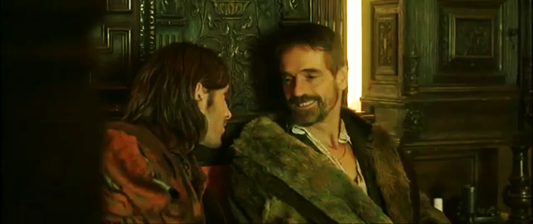
So they went to-
Antonio said, “This is not a problem my friend, how much do you need?” “ Three thousand ducats (Venetian currency) will do.”“ I don’t have that much money with me now as all my ships have gone out in the sea with merchandise. But don’t worry my friend, I’ll arrange three thousand ducats for you.”
Notes:
Antonio assured Bassanio and went to Shylock for money.

Slide 24
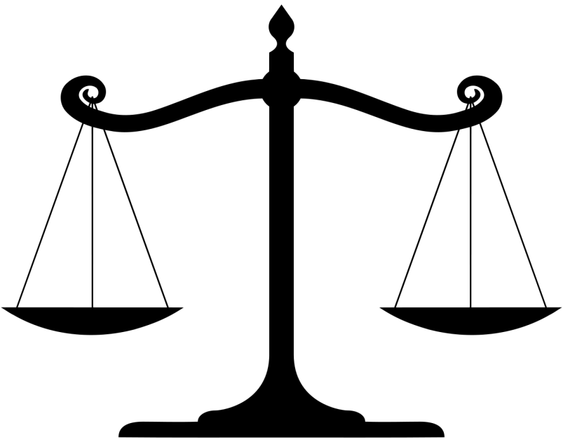
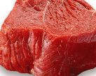
Shylock agreed to lend him money but on one condition. If he failed to repay the money in three month’s time then he has to pay a penalty. Shylock would cut a pound of flesh from any part of Antonio’s body.
1p
Notes:
Shylock agreed to lend money to Antonio but in one conditon.

Slide 25
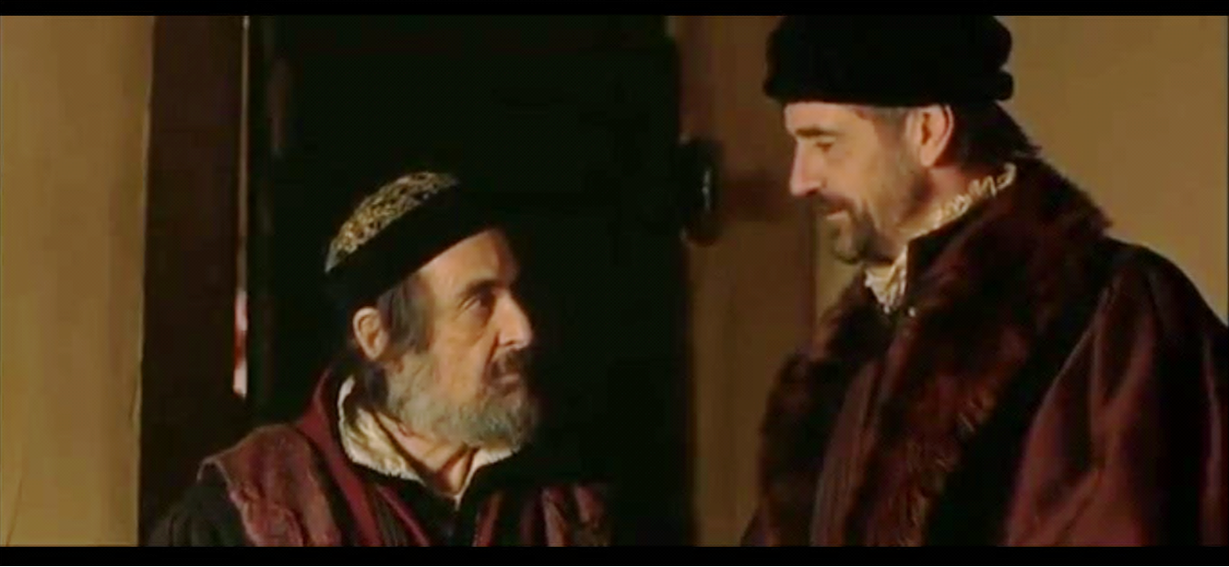
Have a look at the next content to enjoy the love and marriage of Bassanio & Portia.
Antonio willingly agreed thinking that his ships would soon return with all the rich merchandise and he can easily return the money to Shylock by selling them. Shylock made Antonio sign a bond before giving him the money. Antonio took the money and gave it to Bassanio.
Notes:
This content is the first episode of the legendary drama series “The Merchant of Venice.” by William Shakespeare. The 2nd episode is more interesting than this episode. The third and grand episode is the most touching, amazing as well as interesting among the three episodes. Teacher may invite the students to enjoy all the three episodes accordingly.

Slide 26
Teacher may conduct the rest of the lesson manually with text book, board, marker and other elements needed.
Notes:
Text item. This part may conducted through manual method to survive connection with text book.

Slide 27
Dear students,
Open your text book at page 176 and read section B to answer the questions below the text. I will help and monitor you.
Once upon a time in Venice, there was a very rich merchant named Antonio. He had many ships, that sailed in the sea.…………………….…………………………. It so happened that, Bassanio fell in love with a wealthy lady named Portia. Portia was known not only for her beauty but also for her wisdom. Portia, on the other hand, had softness towards Bassanio too
Notes:
Teacher may conduct this according to the direction of the text book.

Slide 28
C True or false? If false, give the correct information.
1 Bassanio was a very rich man.
2 Bassanio and Antonio hated each other.
3 Antonio went to Shylock to borrow money.
4 Shylock happily gave Antonio the money he asked for.
5 Antonio needed the money to my merchandise.
D Read the text in B again and answer the following questions.
1 Why was Bassanio short of money all the time?
2 Why did he go to Antonio?
3 Why did Antonio go to Shylock?
4 Why did Shylock bring forward the bond?
5 What could be written on the bond?
Notes:
Evaluation option through section C & D.

Slide 29
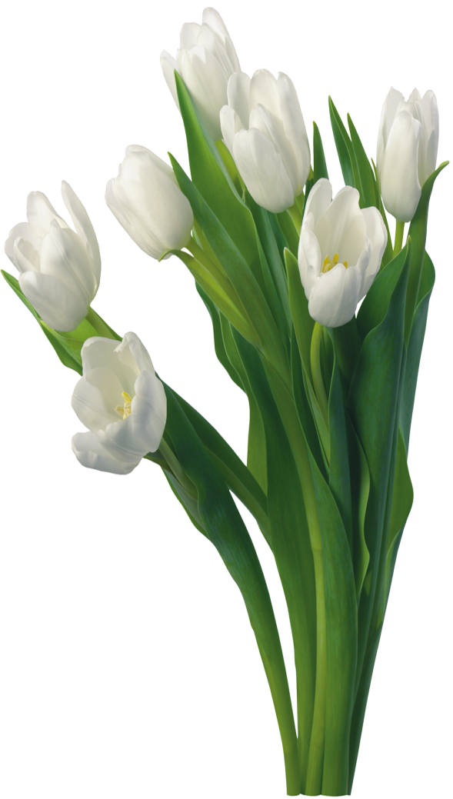
May Allah bless you all.
Notes:
Teacher may invite the learners to enjoy the next episode in this ending slide.

